Slide 1


RooSy Room System
Overview
Wall System
Door System
Integrated Products
Comparisons
References
Certificates

Slide 2
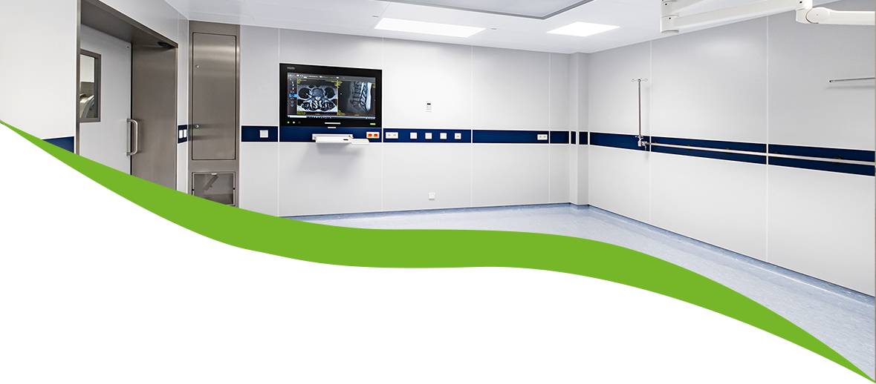

RooSy Room System
Room System

Slide 3
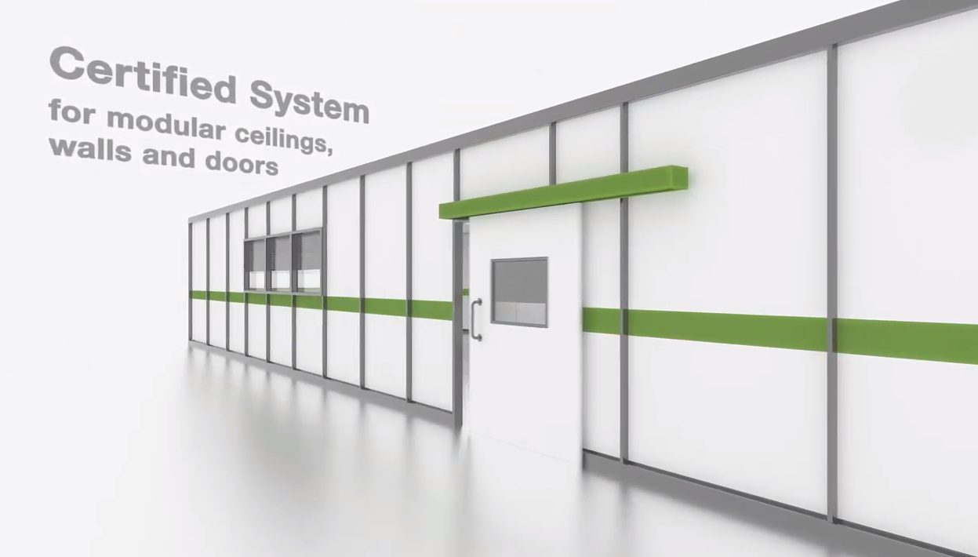

RooSy – Video

Slide 4
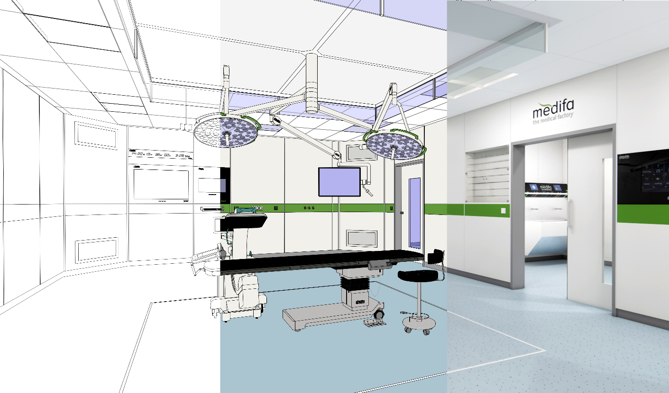
All-Around Package
Planning and Consulting
Engineering
Project Management
Production
Logistics
Assembly and Service

Slide 5
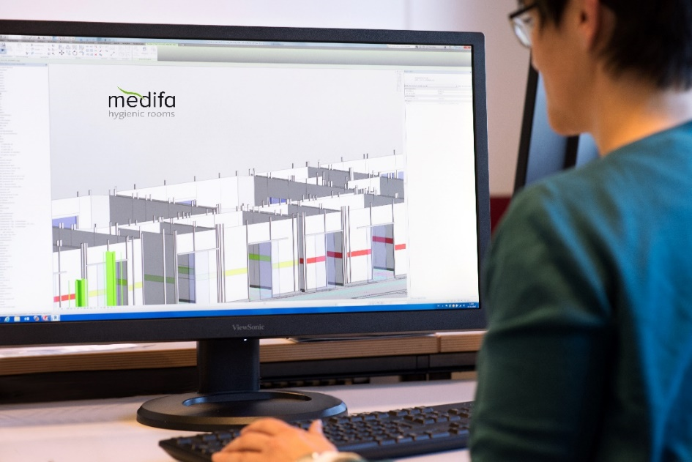
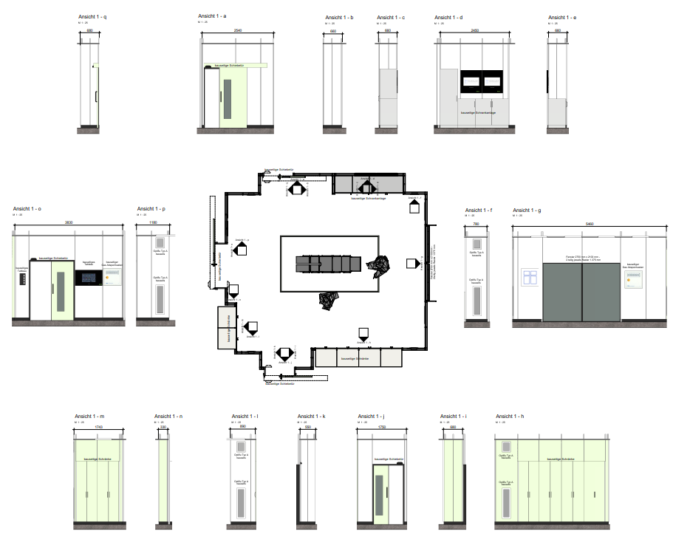
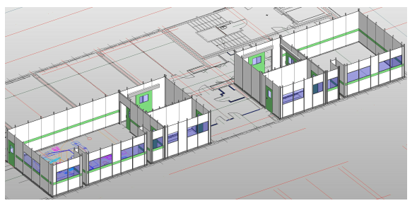

Planning & Construction

Slide 6
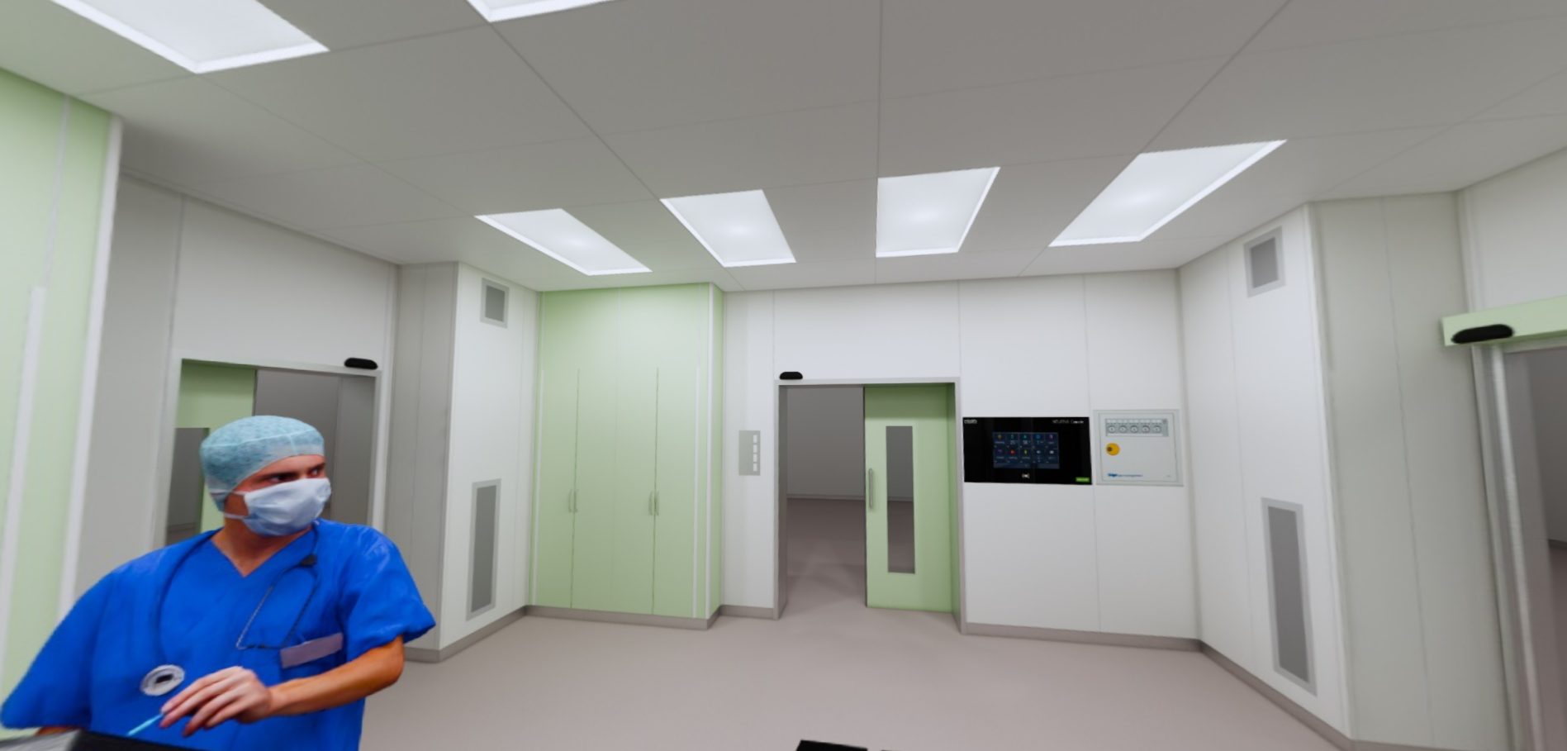


3D Visualization
Planning & Construction
Realtime Rendering

Slide 7
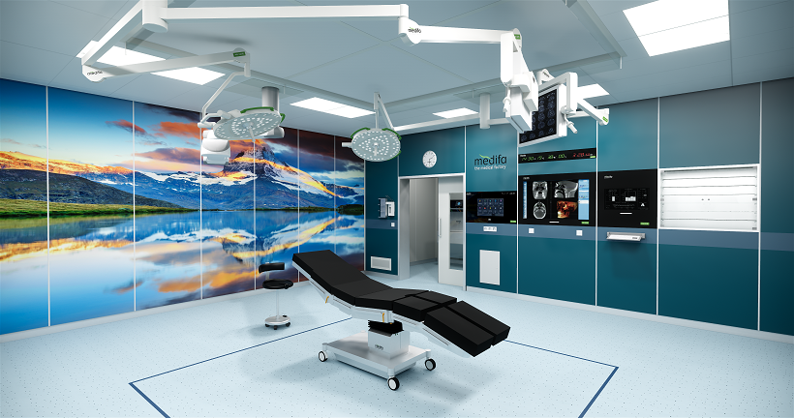
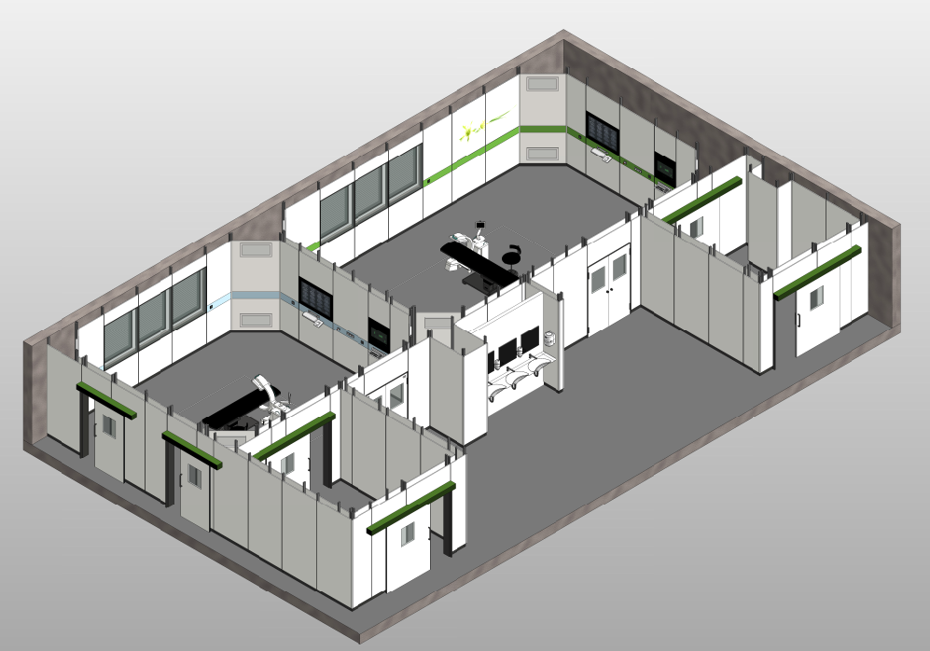
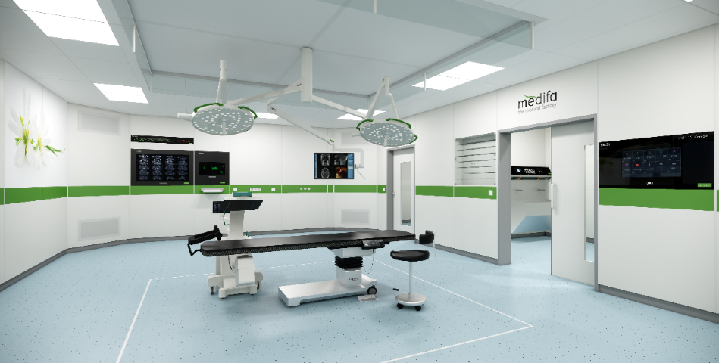
Planning & Construction

Slide 8
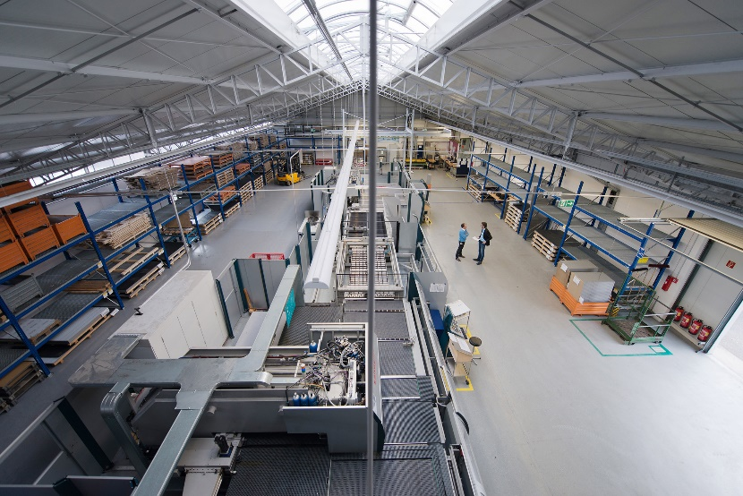
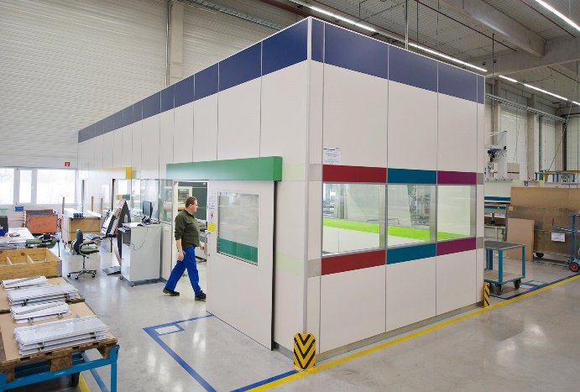
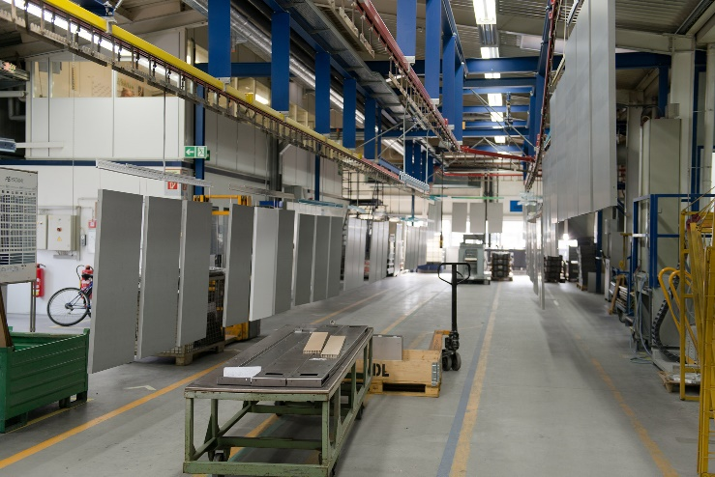
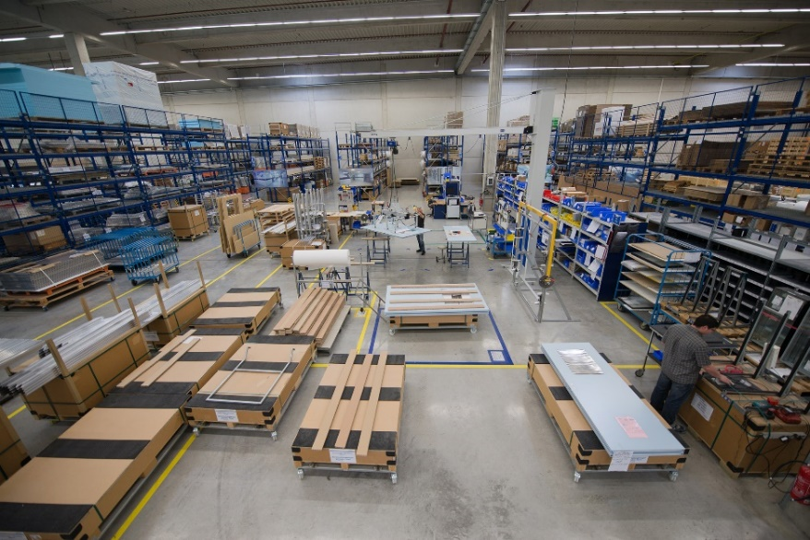
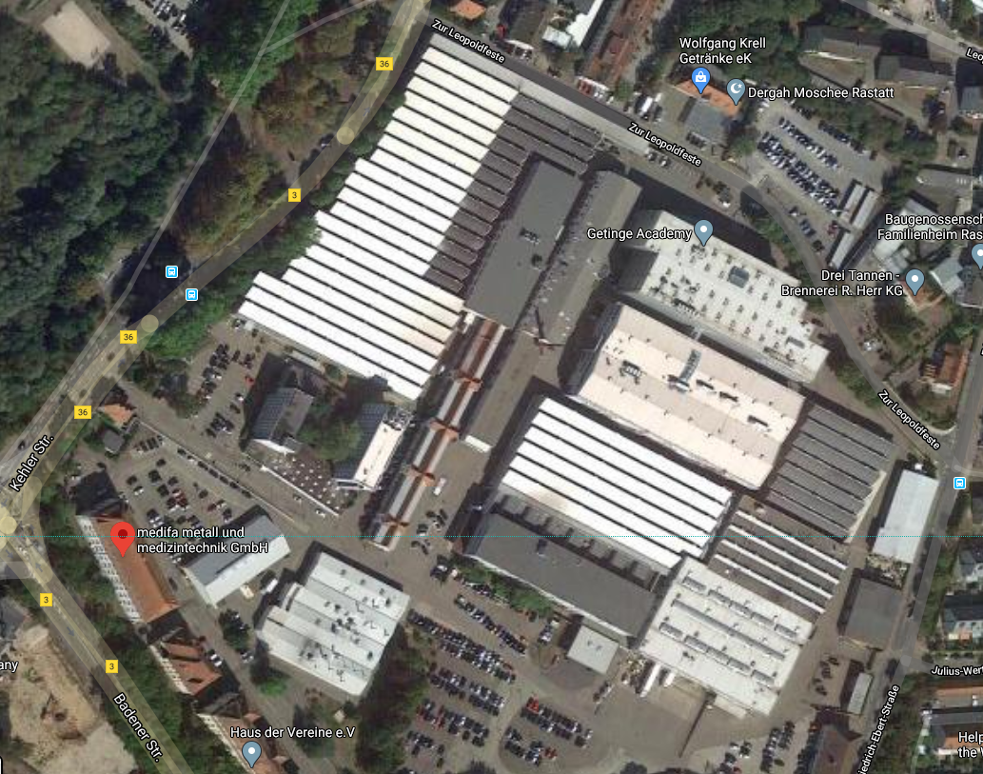
Own Production in Germany – Rastatt & Ötigheim
Rastatt
Ötigheim

Slide 9

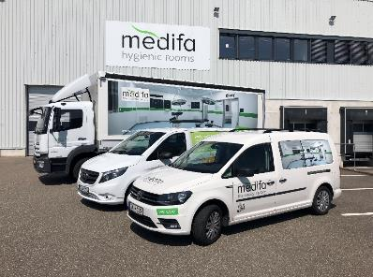
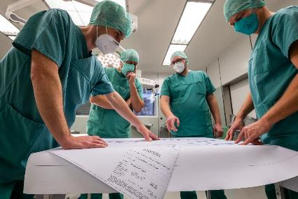
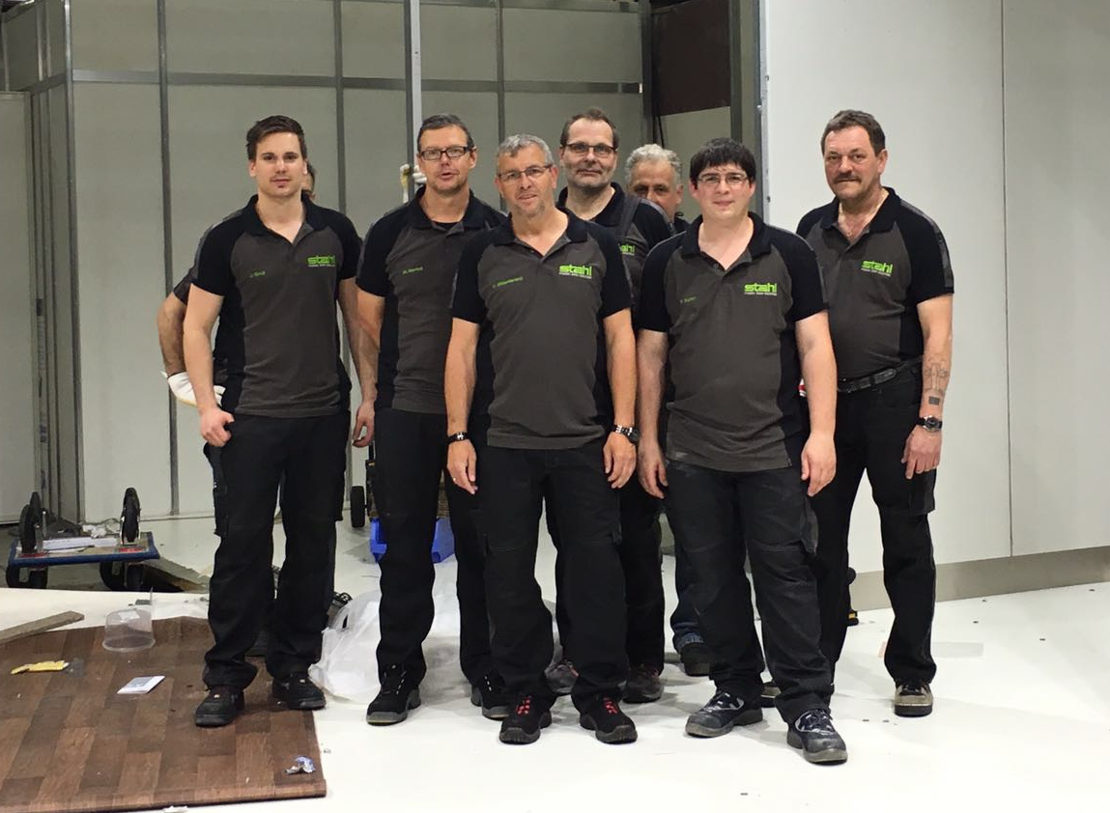
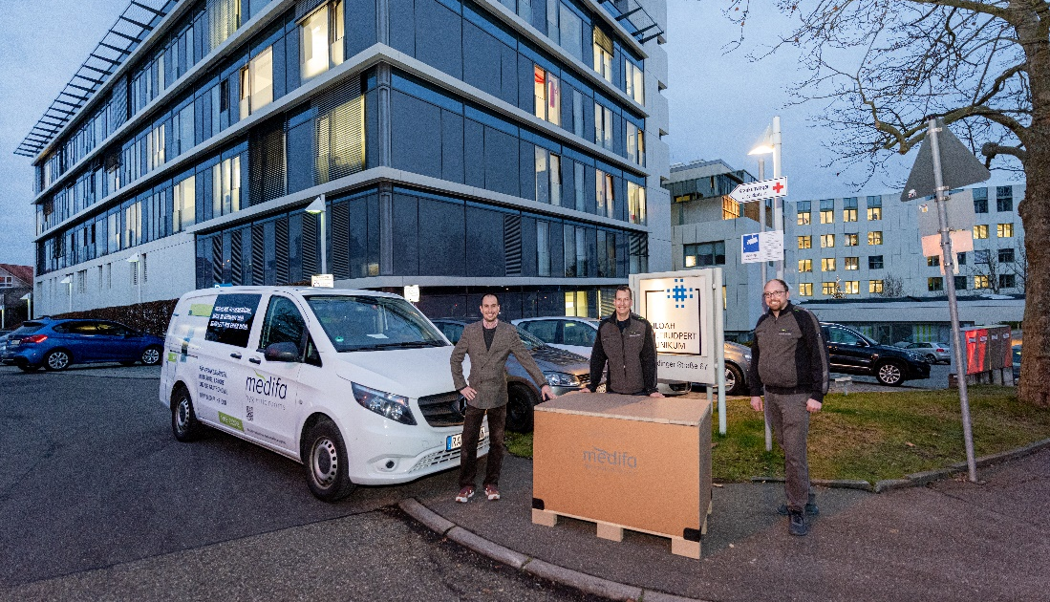
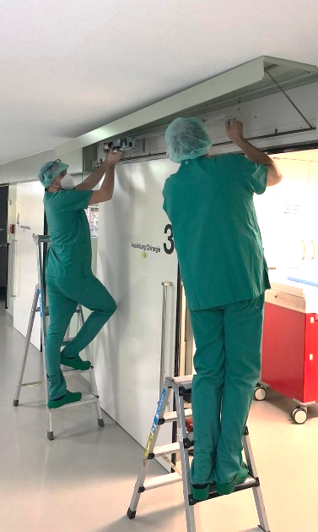
Assembly & Service

Slide 10
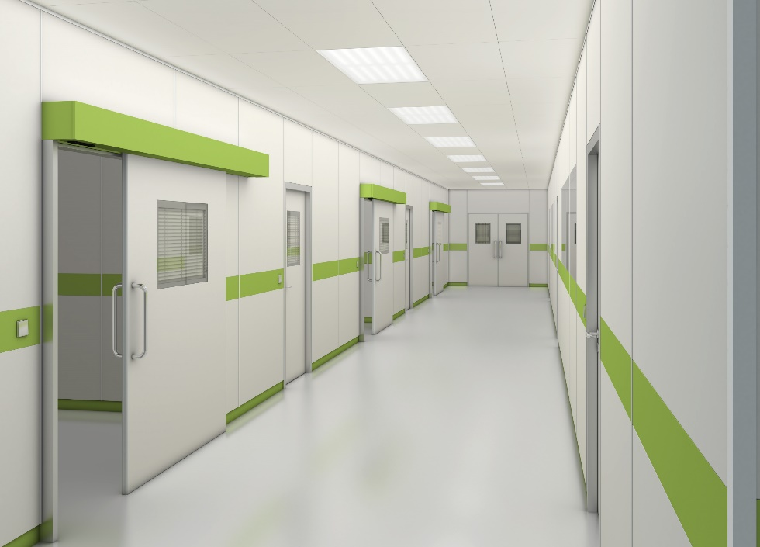
Scope of Work
Ceiling Lights
Metal Ceiling
Wall Element
Hinged Door
Door Frame
Sliding Door
Flush Windows or Elements

Slide 11
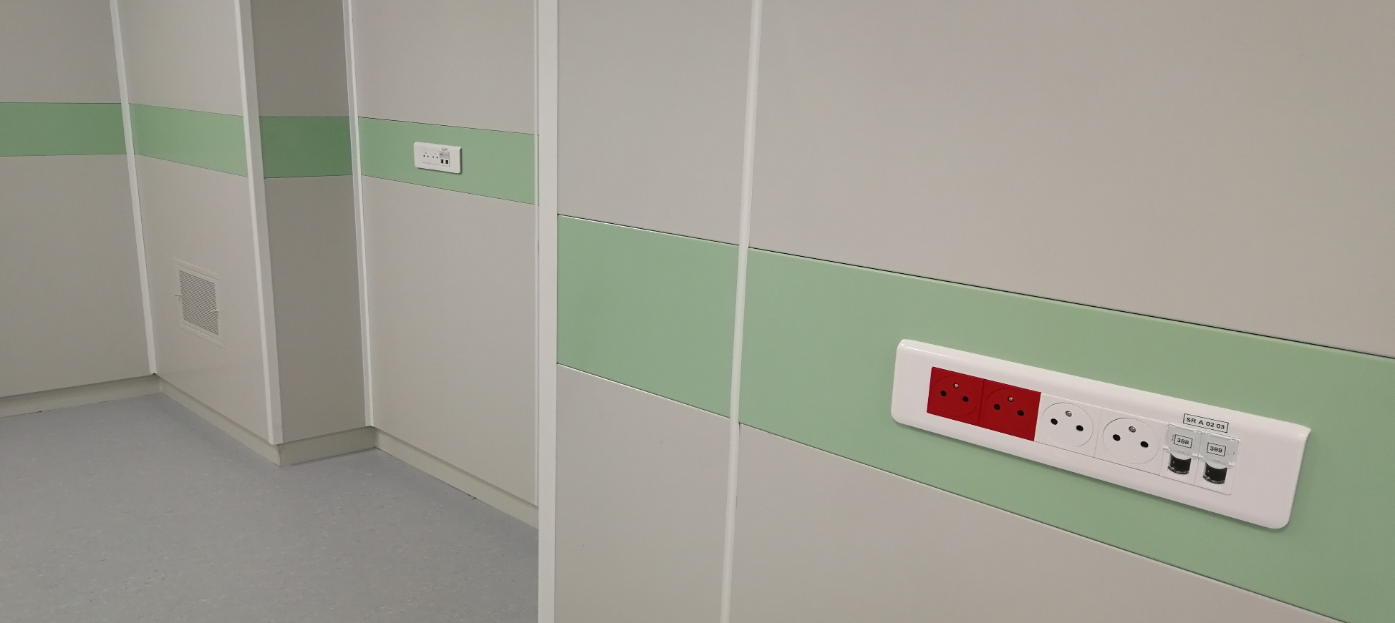

Wall System
Wall System

Slide 12
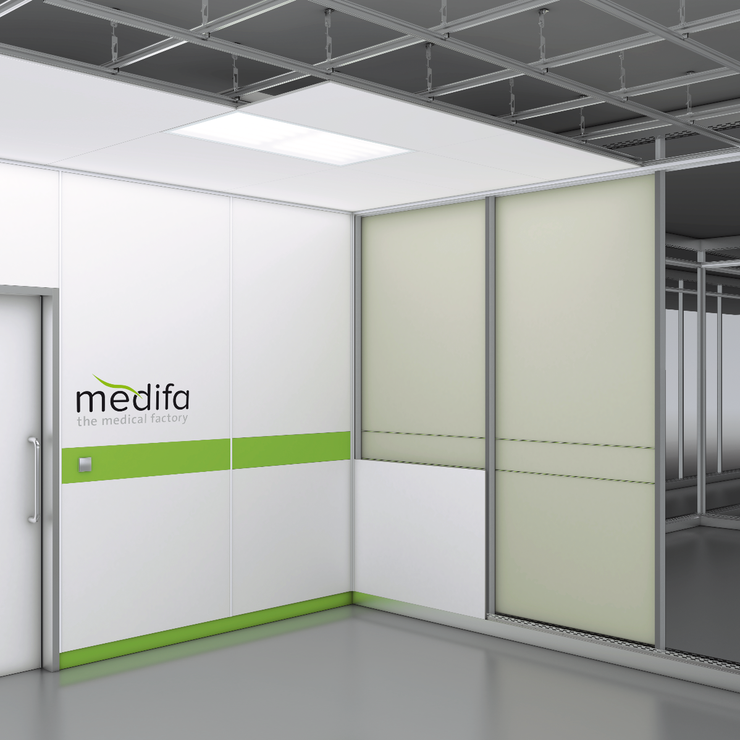
Structure of RooSy Wall System
Ceiling Rail
Support Profile
Top Wall Element
Installation Level
Fastening Brackets
Bottom Wall Element
Floor Rail

Slide 13
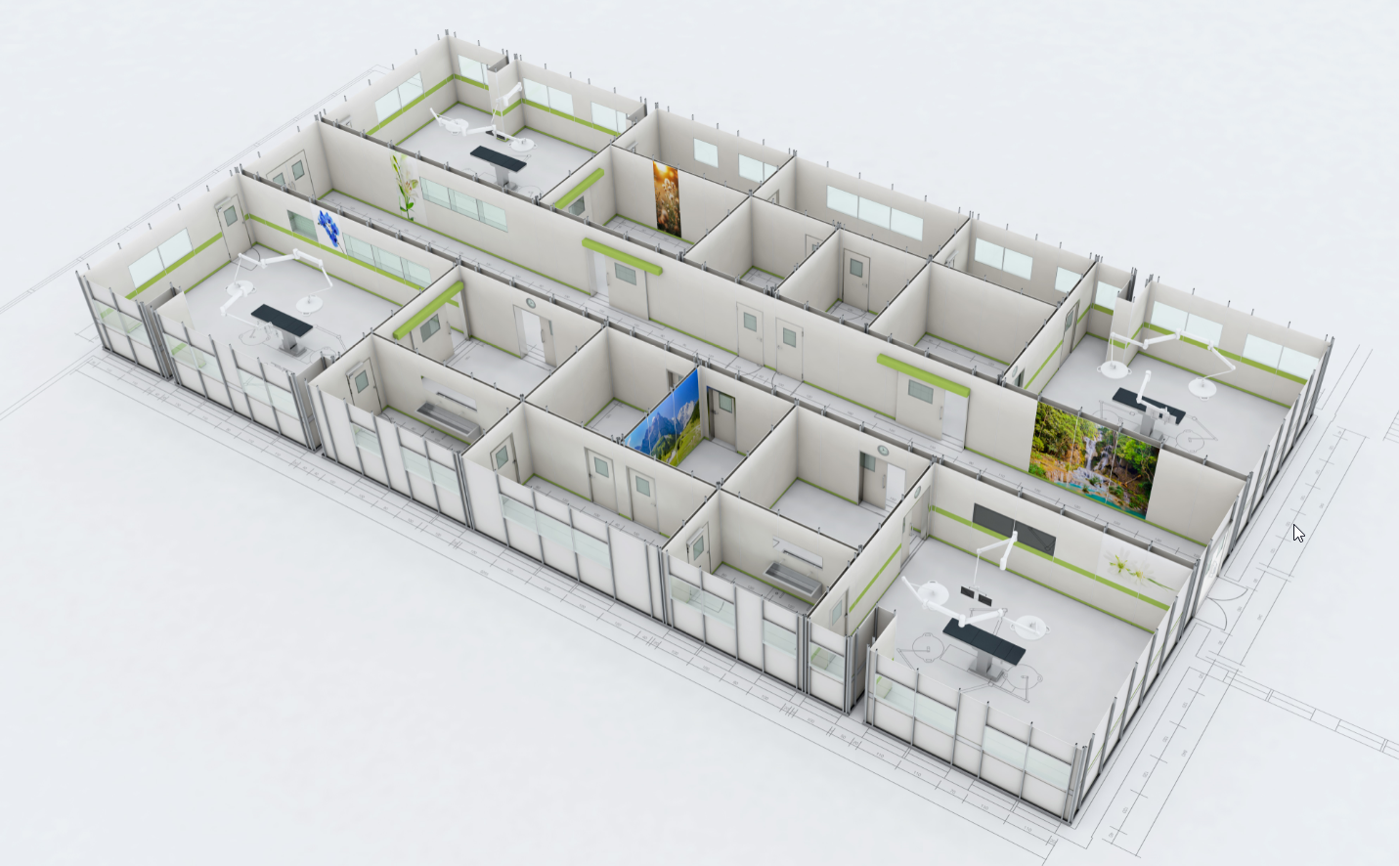
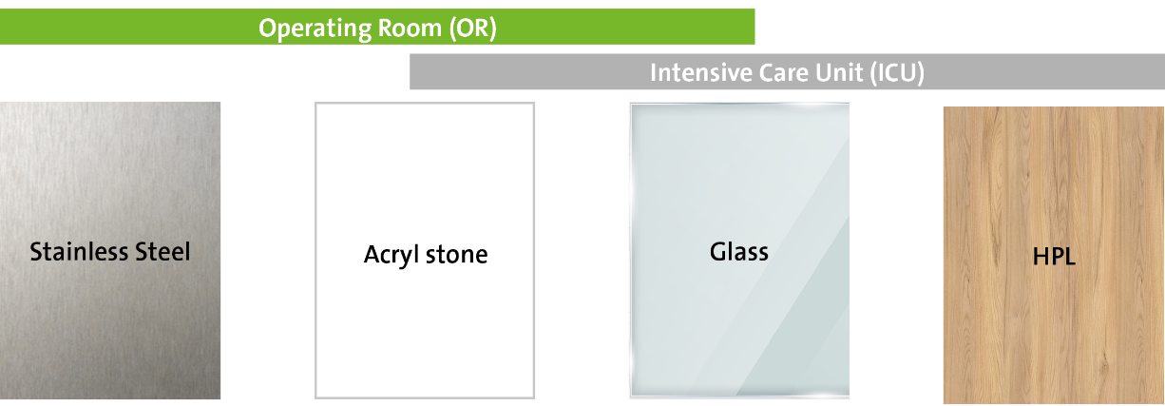
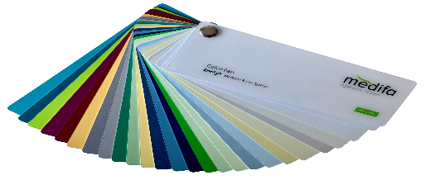
One Substructure System – One Solution
Hospital Area
OR / CSSD / ICU etc.
Cladding Material

Slide 14
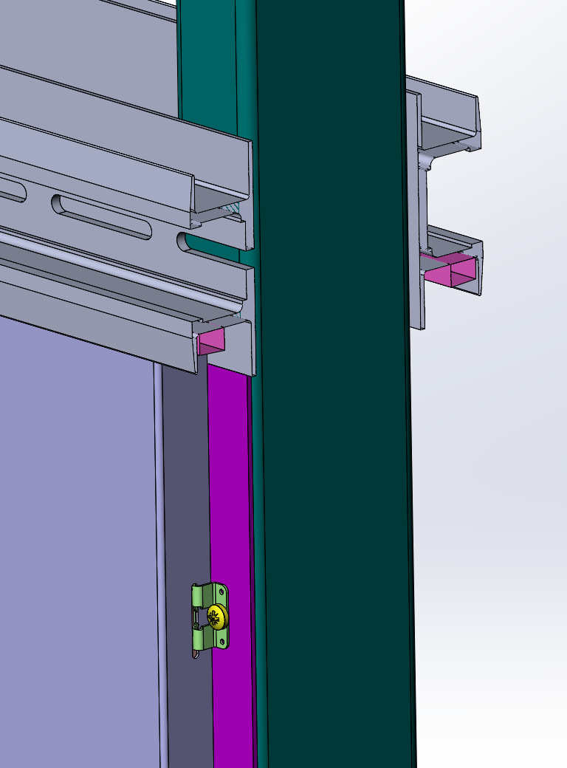
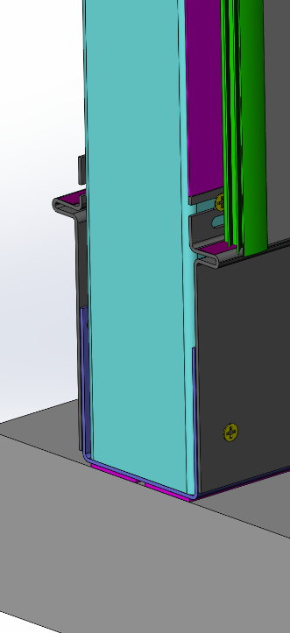
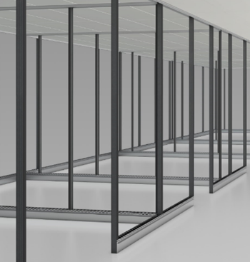
Substructure
Ceiling Rail
U-profile / Connection Ceiling
Gap Profile
Sealing Tape
Sealing Tape
Support
Sealing Tape
Supports
Wall Element
Fixing Clip
Support
U-profile and Base Sheet / Connection Floor
The flexible and self-supporting substructure ensures the most scope during the construction phase and ensures a long lifetime.

Slide 15
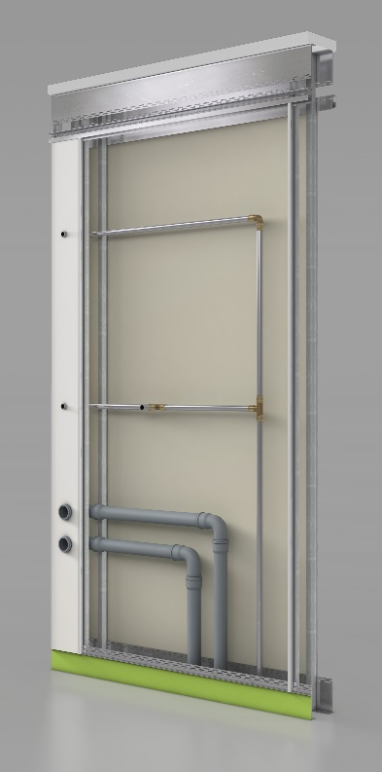
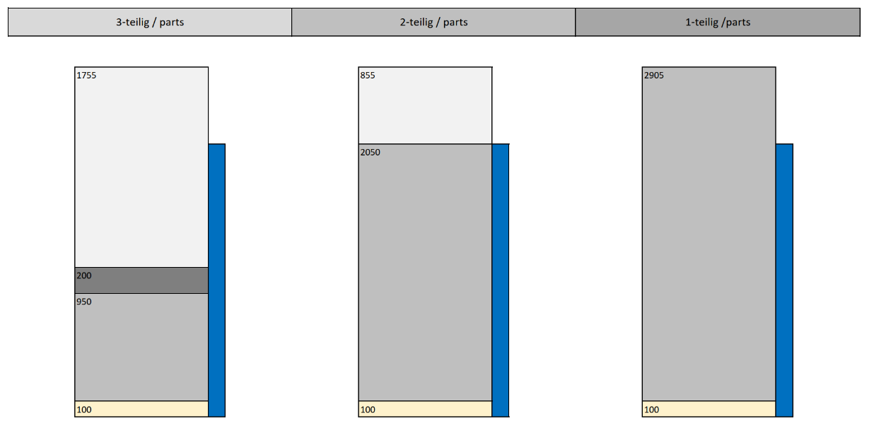
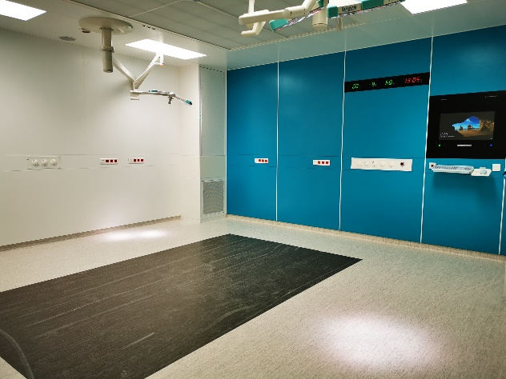
Installation Space & Wall Covering
Area between the wall elements can be used for installations.
Different types of wall cladding: 3-part / 2-part / 1-part.
Different types of walls:
Single shell / Double shell / Wall in front of an existing wall.

Slide 16
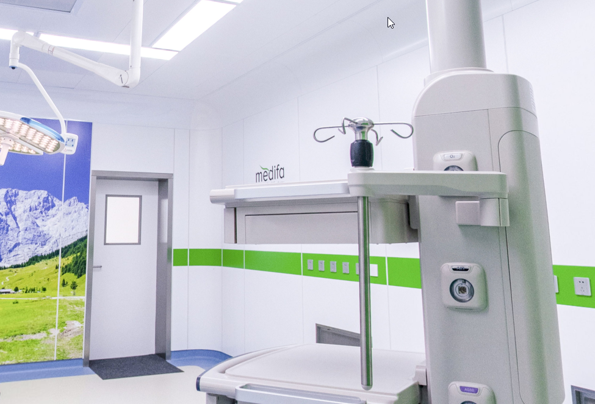
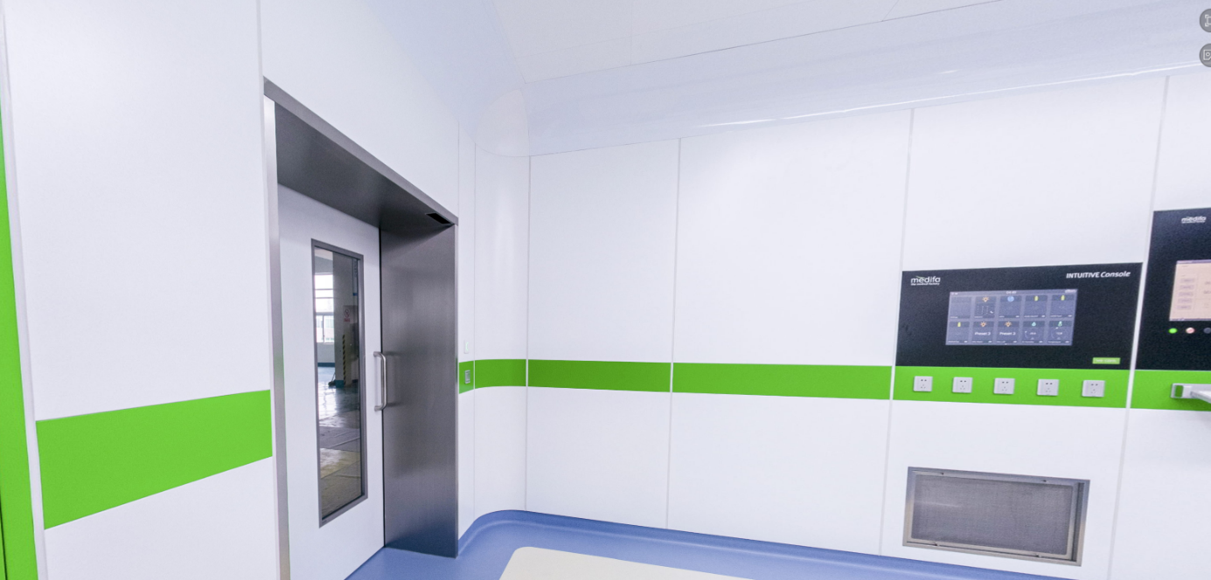
Round Corners & Round Ceiling Rail
Round corner & ceiling rail with radius 50 mm.
Round corner & ceiling rail with radius 300 mm.
Connecting element round corner and ceiling rail for both solutions.

Slide 17
Door Systems
Door System
Door System

Slide 18
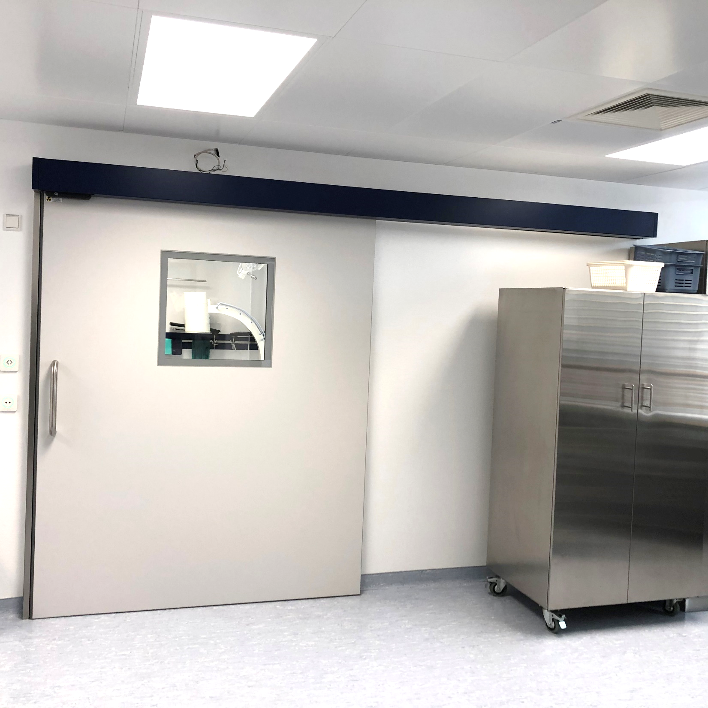
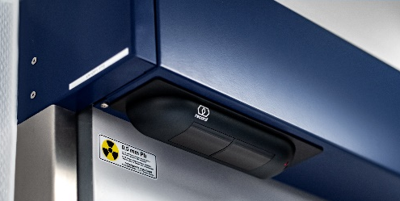
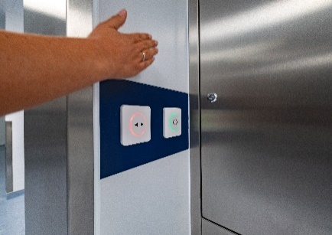
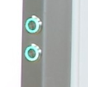
Integrated Sliding Door System
Integrated sensor
Running gear
completely pre-assembled
Touchless switches
single-leaf or double-leaf
Integrated switches
Aluminium frame
inside door leaf for high stability
Window
flush integrated window
Stainless steel frame without vertical gap or silicon
Optional:
floor seal for hermetic function

Slide 19
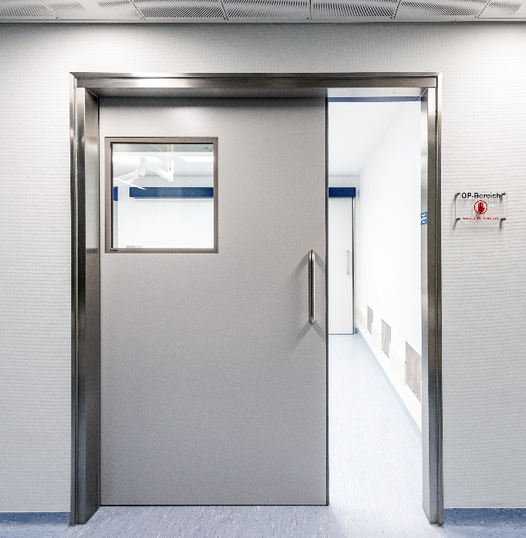
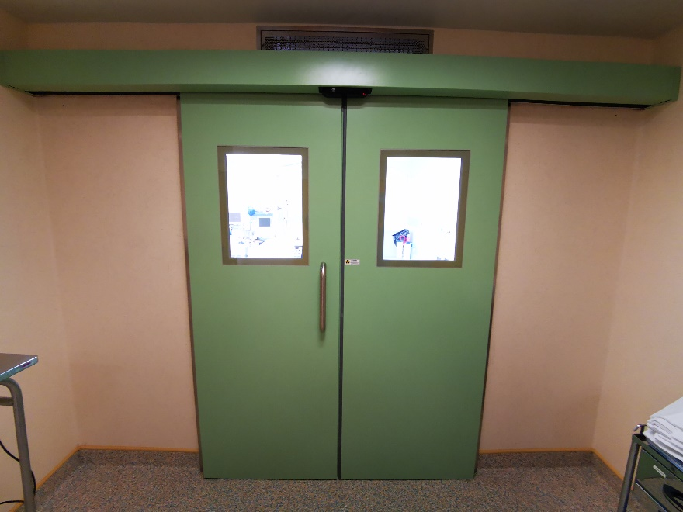
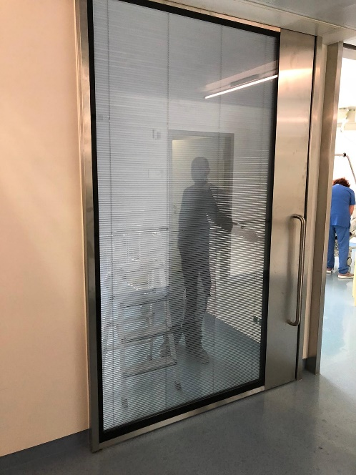
Different Types of Sliding Doors
Automatic or manual
1-leaf or 2-leaves
Glass doors
Doors according to customer requirements

Slide 20
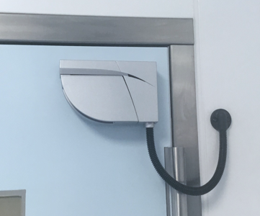
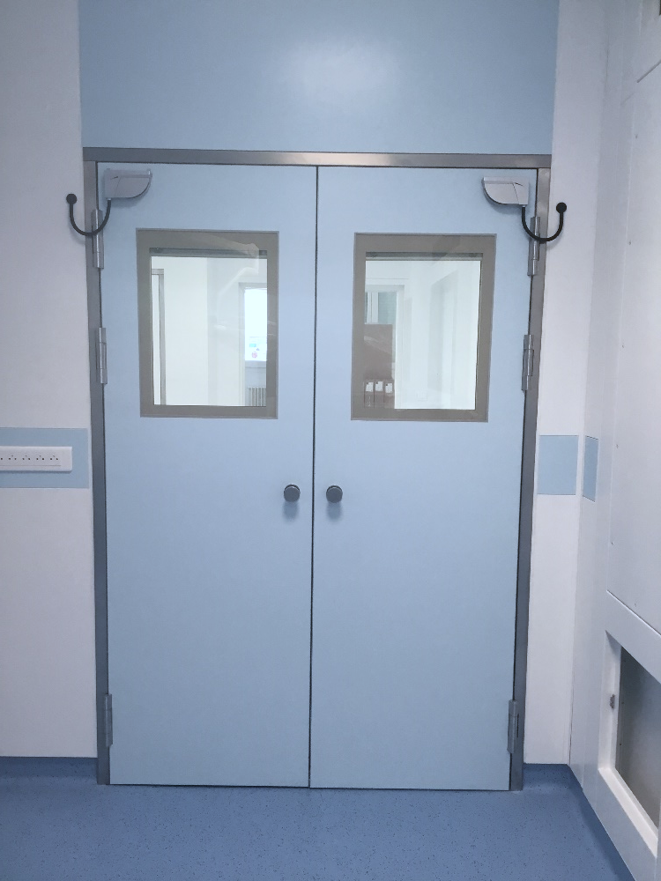
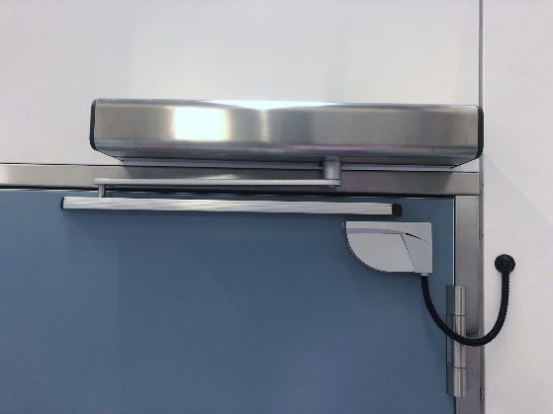
Integrated Hinged Door System
Hinged door leaf
Perfectly adapted sensors
Stainless steel frame without vertical gap or silicon
Aluminium frame
inside door leaf for high stability and perfect connection to the automatic bar.
High class door hinges
Optional:
floor seal for hermetic function

Slide 21
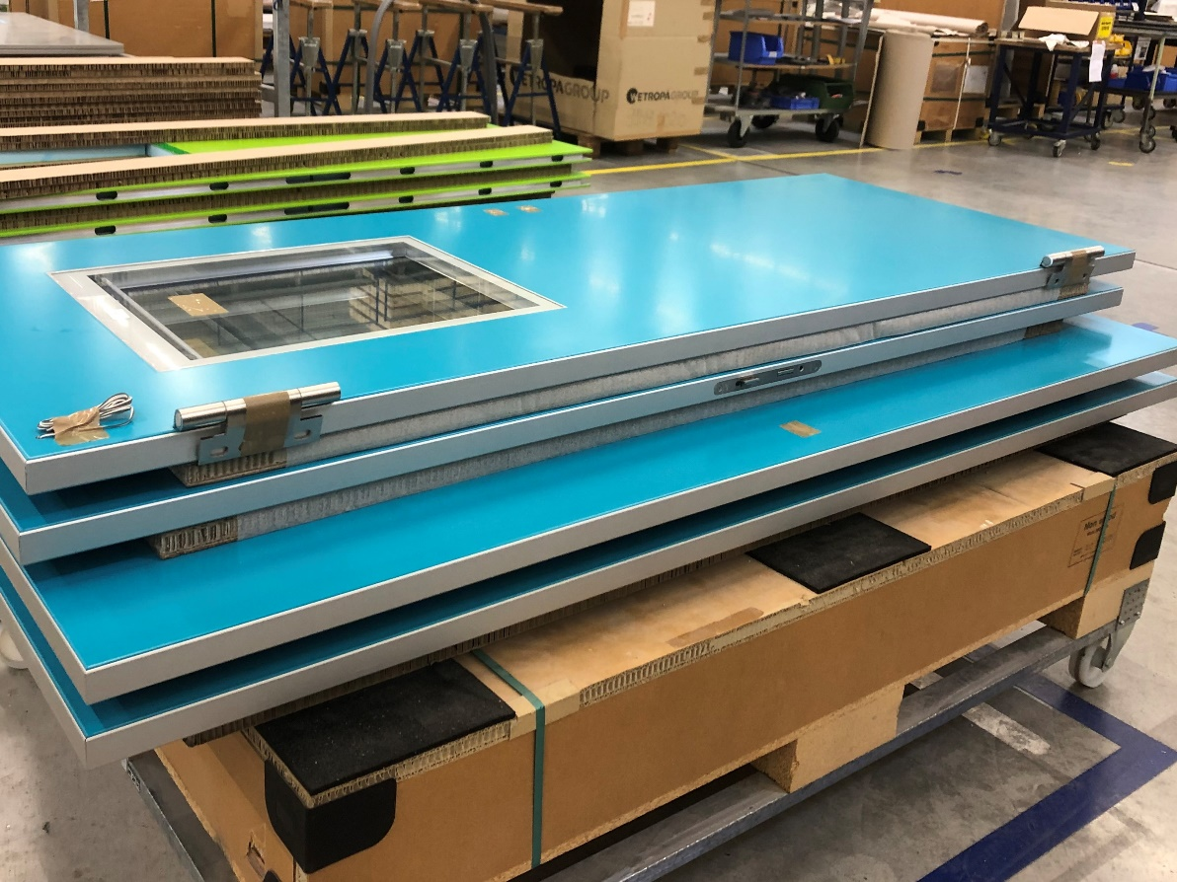
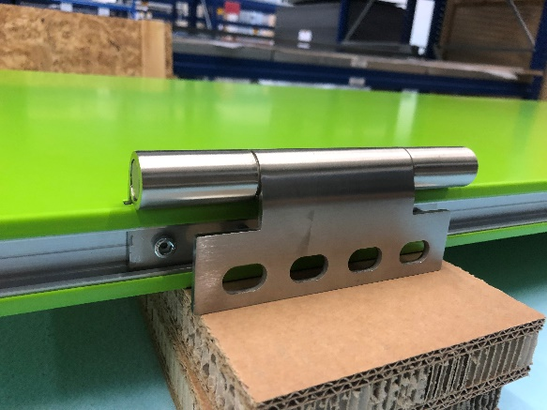
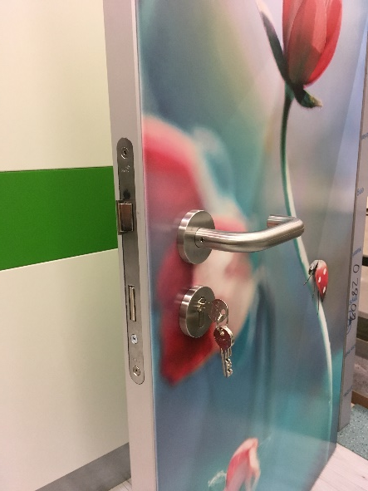
medifa Hinged Door Solutions
High-class stainless steel hinged
Flush-mounted strike plate
Aluminium termination strip

Slide 22
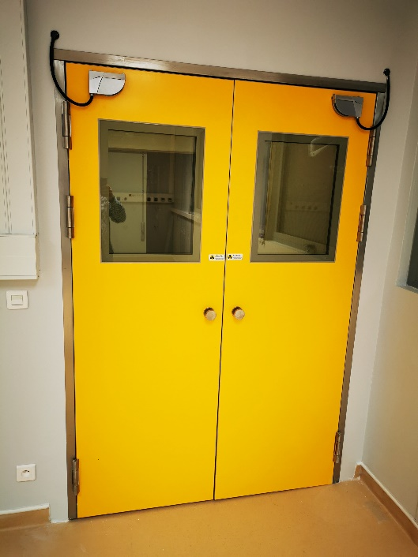
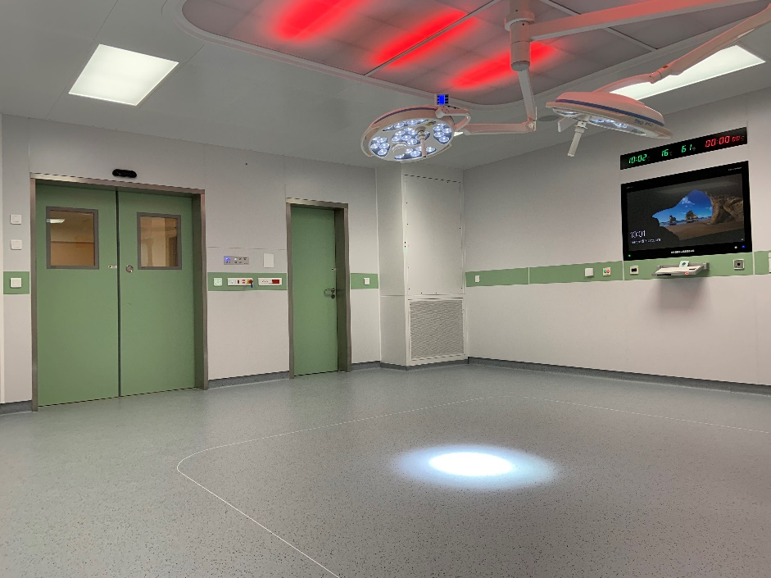
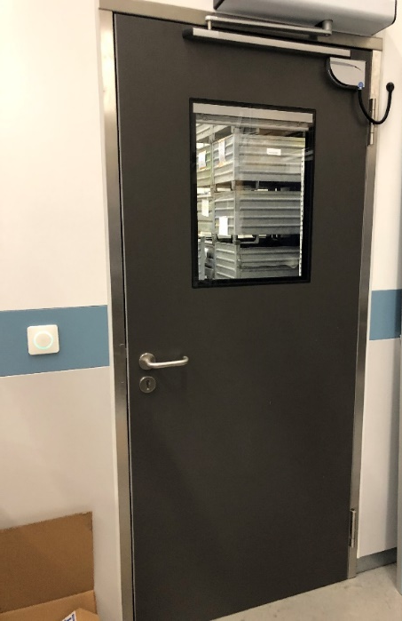
Different Types of Hinged Doors
Automatic or manual
1-leaf or 2-leaves stainless steel doors – powder coated
1-leaf HPL doors
Doors according to customer requirements

Slide 23

Integrated Products
Integrated Products

Slide 24

Intuitive Console – Room Control
Touchless
RFID
Light Control
Room Parameters
Different
Languages
Customizable

Slide 25








Buildt-in Components
Senso Clean
Sink
Screen
SID – Surgeon Information Display
Cabinets
Laminar Airflow
Exhaust Air Duct
Control Panel

Slide 26




Clean Room Lights and Design Elements
Integrated flush mounted ceiling system
LED – RGB - Dali
Different sizes (1.200x600 mm – 600x600 mm – 1.200x300 mm)
Sky panels as design elements

Slide 27





Special Solutions
Customer design for window connection
Customized front panels
Customized top boards
Corner protection elements
Installation walls

Slide 28
Comparisons
Comparisons

Slide 29




Flush Fittings
Flush Fittings
of Competitors:
medifa Flush Fittings:
Installation cupboard
Monitor placed on the wall
Infobar & monitor
Material catgut

Slide 30





Corners
Corner of Competitors:
medifa Corners:
Corner build „in one piece“.
Few balance options at dimensional changes in the room
With steel sheet rust formation possible
If dented are created on the corner elements, these are difficult to replace/ high costs arise
Corner profile
powder-coated „white“
Corner profile
without powder-coating
Inner corner
Corner profile made of aluminium >>no rust formation possible<<

Slide 31




Doors
Door Panel of Competitors:
medifa Door Leaf:
Four-sided inner frame of the door made of sturdy aluminium profiles
Filling made of foam core XPS
Stable and easy to change door seal
Door panel with wood core filling
Door seal is difficult to change

Slide 32





Frames
Frames of Competitors:
medifa Frames:
Lacquered door frames
scratched paint- unhygienic
Lacquered door frames
side protected with painted stainless steel sheet
Three part door frame made of stainless steel
Door leaf made of stainless steel, powder-coated
Flush-mounted door window 2 mm Pb
Switch in frame installed with self-explanatory pictograms

Slide 33

References
References

Slide 34




Germany – Wirbelsäulenzentrum – Offenbach
Completion: August 2020
Start of installation: End of July 2020
Number of hospital beds: 4
Number of hospital operating rooms: 1
Number of rooms done by medifa: 1 operating room, two additional sliding doors, 4 rooms with ceiling and lights
Scope of supply: Wall system, automatic and manual sliding doors, ceilings, lights, RooSy screen
Work performed: Planning, production, delivery and assembly

Slide 35




Switzerland – The Circle – Zürich
Completion: August 2020
Number of hospital operating rooms: 10
Number of operating rooms: 3
Number of small surgery rooms: 7
Scope of supply: Wall system with radiation protection (0,5mm Pb), automatic sliding doors (0,5mm Pb), ceilings, lights, exhaust air ducts, air supply elements
Work performed: Delivery and assembly of 3 operating rooms and 7 small surgery rooms

Slide 36



China – Chengdu
Completion: October 2020
Number of Show rooms: 2
Number of rooms done by medifa: 2 operating showrooms
Scope of supply: Wall system (stainless steel and glass), round corners, automatic sliding doors (2 pcs.), hinged doors, Intuitive Console, SID, Laminar Air Flow, printed & illuminated wall elements, cabinets & Catgut cabinets, ceiling
Work performed: Planning, production, delivery of 2 operating showrooms

Slide 37




France – St. Denis Reunion
Completion: November 2019
Number of hospital beds: 1.400
Number of hospital operating rooms: 25
Number of rooms done by medifa: 2 operating rooms, 4 additional sliding doors
Scope of supply: Wall system, automatic sliding doors, ceilings, lights, Installation boxes in special construction
Work performed: New construction of 2 operating rooms in an existing building,
Planning, production and installation

Slide 38




Germany – Ev. Krankenhaus – Herne
Completion: October 2019
Number of hospital beds: 445
Number of hospital operating rooms: 5
Number of rooms done by medifa: 2 operating rooms, 2 prepare rooms and 2 wash rooms
Scope of supply: Wall installations for the implementation of imaging systems
Work performed: Planning, test stage, production and assembly of the installation walls in various
construction stages. → Further rooms are built in the same system.

Slide 39

Certificates
Certificates

Slide 40
1. Structural Engineering
Certified:
DIN EN ISO 10140-2
DIN 4103-1 / installation area I and II
Accomplished at the Braunschweig Institut - MPA
(Materialprüfanstalt für das Bauwesen)

Slide 41



Practical Static Test – Braunschweig – Germany

Slide 42


Pendulum Test

Slide 43


Certificate Pendulum Test

Slide 44
2. Airborne – Sound – Measurement
Certified:
DIN EN ISO 10140-2 : 2010
Accomplished at the Stuttgart Institut - MPA
(Materialprüfanstalt der Universität Stuttgart)

Slide 45


Measurement Results of the Airborne Sound Measurement
DIN EN ISO 10140-2 : 2010

Slide 46



Experimental Setup

Slide 47
3. Blower Door – Measurement
Certified:
According to DIN EN 13829, process B
According to DIN 4108 (2011) for building ventilation systems
Tested in Showroom – Factory Ötigheim

Slide 48
Explanation of the Measurement Method and Measurement Results
Blower Door measurement method
Approved measurement method for the air permeability measurement on executed buildings
This procedure is performed as a differential pressure measurement (Measurement after generation of a low-/ overpressure in the finished measurement object).
Air exchange rate
Airtightness according to DIN EN 13829 process B at 50 Pascal: n50 = 1,0 1/h
Airtightness according to DIN 4108 – 7 (2011) for building ventilation systems: n50 < 1,5 1/h
The requirements are met

Slide 49

Experimental Setup

Slide 50


Certificate Blower Door Measurement

Slide 51


4. Hygienic Certificate
Certified:
Checking the disinfect ability of wall and door systems
According to DIN EN 12353 / DIN EN 16615
Tested by Institut für Krankenhaushygiene IKI – Gießen / Germany

Slide 52

Tested Areas
Two test germs (Staphylococcus aureus ATCC 6538 & Acinetobacterbaumannii ATTC 19606) were applied
The cleaning / disinfection was carried out with 4 different disinfectants (Microbac forte / Bacillol / Kohrsolin FF / Perform)

Slide 53


Certificates Hygiene

Slide 54
Certificate ISO 9001

Slide 55
Thank you for your attention!
medifa hygienic rooms GmbH
Heinrich-Hertz-Str. 4
D-76470 Ötigheim
Tel: +49 (0)7222 783 68 - 0
GERMANY

